Slide 2
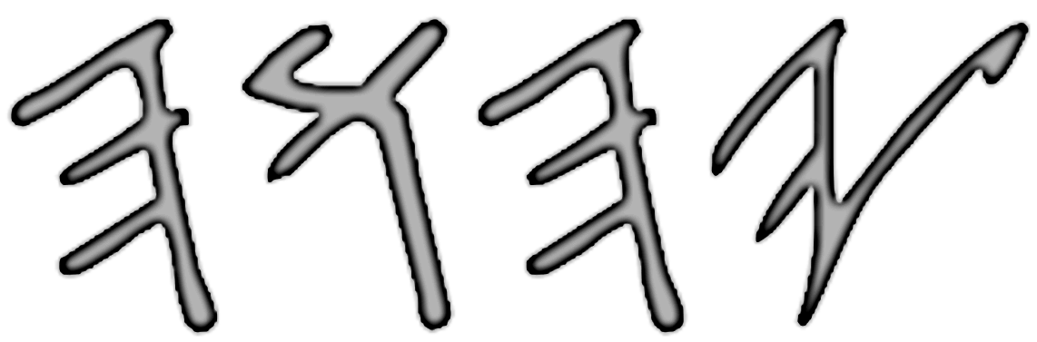
This imagine of what might looks like is the promise new kingdom of coming down from heaven based on what the Revelation chapter 21 said. Where will dwell in this place, along with HIS children of Israelites after the last day. Where Jesus prepares a place for the worthy people after the great tribulation day.

Slide 3
Priest, Pastors and/or teachers have foretold us about this for generations after generations. A huge square like cube foundations walls around its golden city. A names of the twelve apostles of the Lamb (Christ) are written on it. And the12 tribe of Israelites’ name are written above the entering gate.

Slide 4
We were often told about this coming New Kingdom as the 3rd Temple. Claiming that this new city of Jerusalem is where Jesus will prepare a place for us (according to John 14:3), saying it will come down from heaven. That this place is somehow part of what the book of Ezekiel tell us about the future 3rd temple where will dwell. A new kingdom that will rule on earth forever and ever etc… (Revelation 21:2).

Slide 5
The truth is, we have been told a lied about this. Because I, Bro. Pouliot have discovered a mix-up information between the Old and New Testament Bible. About the last day coming forever kingdom.
There are number of problem what the Revelation 21 speak about this coming new kingdom. Conflict with what the Old Testament books teaching.

Slide 6
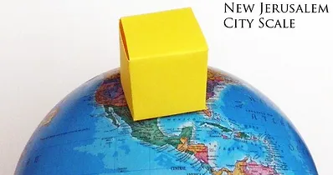
?
?

Slide 7
According to Revelation 21, the size of this New Kingdom is waaaaay to BIG. The size length and its vertical height of the walls around the golden city is 1,500 miles. This is the first thing we might find this interesting and too good to be true.
The first question here is, does anywhere in the Old Testament books speak of anything like 1,500 miles length size walls in the coming new golden city of new Jerusalem?

Slide 8
Since all Yisraelites who left Egypt, only Caleb and Joshua 40 years alone made it to the Promised Land with the younger generation people. Apart from Joshua’s and David’s day is about 350 to 400 years apart.
Moses was long gone; the books of the laws (Torah) was already completed by ’s guided ever since. Both, Joshua and David still obey and kept the book of the laws and ensure that every Yisraelites follow by it.

Slide 9
All they have was this tabernacle and the courtyard, nothing else until one day gave David a new instruction. Instruction to build a temple that is way better then having a tent-tabernacle. Only his son Solomon is to build it for . There were no other instruction to build the walls around it, expect for the tabernacle and the temple.

Slide 10
NO
So, the first question to answer is…..

Slide 11
Until David old age, Yisraelites did somehow bult a security wall surrounding the city. Because in the book of Psalm 51:18-20, it said that David pray about the security wall around the city. They must of have had build the security wall before building the temple.
FYI: The previous answer is still NO, because didn't instruct anyone to built the security wall before or during David’s time.

Slide 12
According to 1st Chronicles chapter 9, all of the chosen gatekeepers who guard the gates were 212. They were registered in the genealogical records of their villages. David and Samuel, the seer had appointed them to their offices.
Verse 23 said that they and their sons guards the gates of the House of , that is, the tabernacle (not the building temple that time).
Verse 24 said the gatekeepers were posted on four sides of walls, toward the east, west, north, and south.

Slide 13
Verse 26, they have four chief gatekeepers, who were Levites tribe, and were entrusted over the chambers and over the treasuries in the House of .
Verse 27 said that they would spend the night around the House of , because they were assigned to guard it and they were in charge of opening the gates morning by morning.

Slide 14
NO
This is why the answer is still...
Because it the surrounding of the temple that they were guarding at it gates.

Slide 15
The next question is, is there any future instruction to build the walls surround the city?

Slide 16
What about the book of Nehemiah?
This book did instructed Nehemiah about rebuilding the walls?

Slide 17
Let’s first know the history about the city of Jerusalem's walls. The main thing to understand, the city of Jerusalem's walls have been changed it size over time. Because of the population grew etc....
Today length of the walls sorrowing the city of Jerusalem is approximately about two and a half miles long. The wall also contains seven main gates open for traffic, with two minor gates reopened by archaeologists. That is nine gates all together.

Slide 18
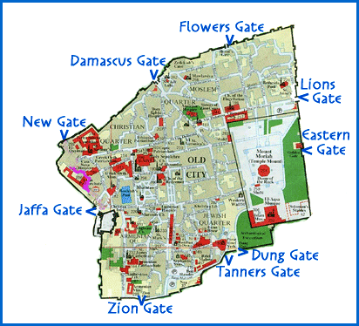
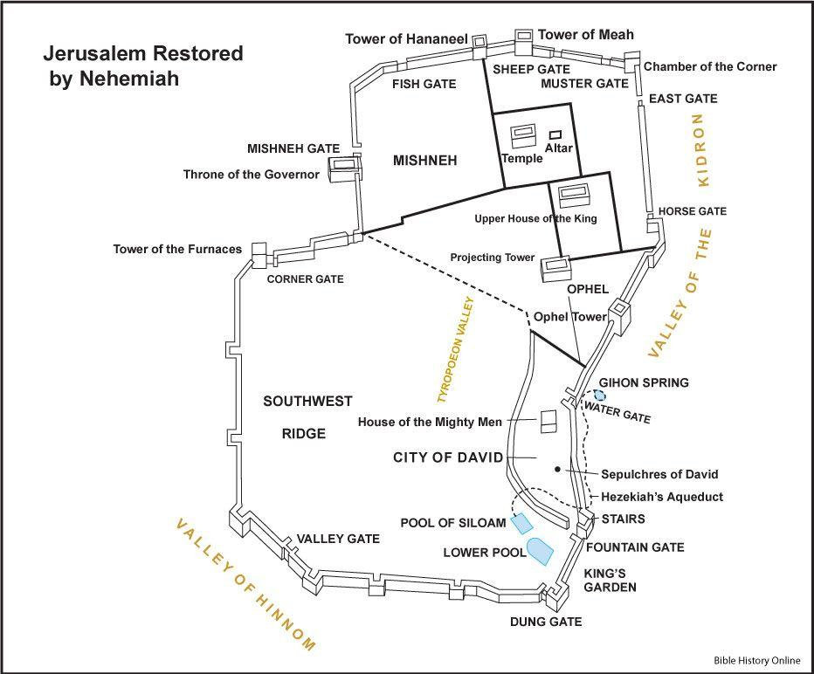
On the left is what the walls surrounding the city of Jerusalem looks like today.
On the right is the time of Nehemiah’s day when he rebuilder the city walls of Jerusalem. Notice the difference between the left and right of the images.

Slide 19
The fact is, Zerubbabel was the one who rebuild the destruction temple for the last 2 years. Then the construction was delayed by Samaritan settlers whose friendly overtures masked a hidden hostility (Ezra 4:1–5). As a result of the opposition to the temple construction, Persia withdrew support for the rebuilding project. The temple sat unfinished for seventeen years (Ezra 4:21).

Slide 20
Finally, sent the prophets Haggai and Zechariah to encourage and support Zerubbabel (Ezra 5:1–2), and resumed the work on the destruction (do NOT used the pagan idea as second) temple to complete it.
Four years later, the temple was finally completed and dedicated with great fanfare (Ezra 6:16). Return the observing of the Sacrifice of Pease Offering Day (Ezra 6:19).
Notice while research, never gave Haggai or Zechariah any of the instruction detail on how to rebuild the temple again. This is because they already have the instruction from King David’s day; who gave the instruction to his son Solomon to build it.

Slide 21
Now you can see why Nehemiah have nothing to do with it. Because there is NO future instruction by to build a walls around the city.
It’s because is our protection wall against the enemy (Isaiah 54:17 & Psalm 34:7).

Slide 22
What about in the book of Ezekiel?
According to chapter 40, Ezekiel had a vision of this New future temple; in the time of the new kingdom. And in chapter 42, he also saw what appear to be a huge walls outside of the temple area????
Once again, what he had prophesied is not the past or the present temple, this is based on during the new kingdom time.

Slide 23
What about in the book of Ezekiel?
536 cubits (804 Ft)
According to chapter 40, there is a different kind of wall, one that is surrounding the temple by four walls, measure about 536 cubits (about 804 ft) each walls.
The wall is only six cubits (about 1 reed or 9 ft) thick and its height as well. So, the walls is only 9 feet tall.

Slide 24
What about in the book of Ezekiel?
536 cubits (804 Ft)
The inner and outer courtyard of the temple have three gates. The measure of the gate area is 60 cubits (about 90 Ft) tall and wide at 25 cubits (about 37.5 Ft). The entering is 13 cubits (about 19.5 Ft).

Slide 25
What about in the book of Ezekiel?
500 Reeds (4,465 Ft)
Wall
The other walls which mentioned in chapter 42:15-20 is far out from the temple and the courtyard area. This wall is built into four-square walls at the same measure length at 500 Reeds (about 4,465 Ft). Since one reed equal 6 cubits long.
TEMPLE
500 Reeds (4,465 Ft)
500 Reeds (4,465 Ft)
Wall
Wall
OUTER COURTYARD
We are talking about the calculated figure for a mile. It turn out to be only 0.84564394 mile. As you can see, this is nothing like what the Revelation chapter 21 speak of.
500 Reeds (4,465 Ft)
Wall

Slide 26
There are some of the information from the Revelation chapter 21; new kingdom that doesn’t sound right.
Verse 22 mentioned that there is no temple in this new kingdom city? Because it said that “the Lord God Almighty and the Lamb are its temple”. While Ezekiel saw there will be a temple in this new kingdom?
What more strange about this is, why is that there two beings as two temples. This false New Testament doctrine is referring to YHWH and Jesus?

Slide 27
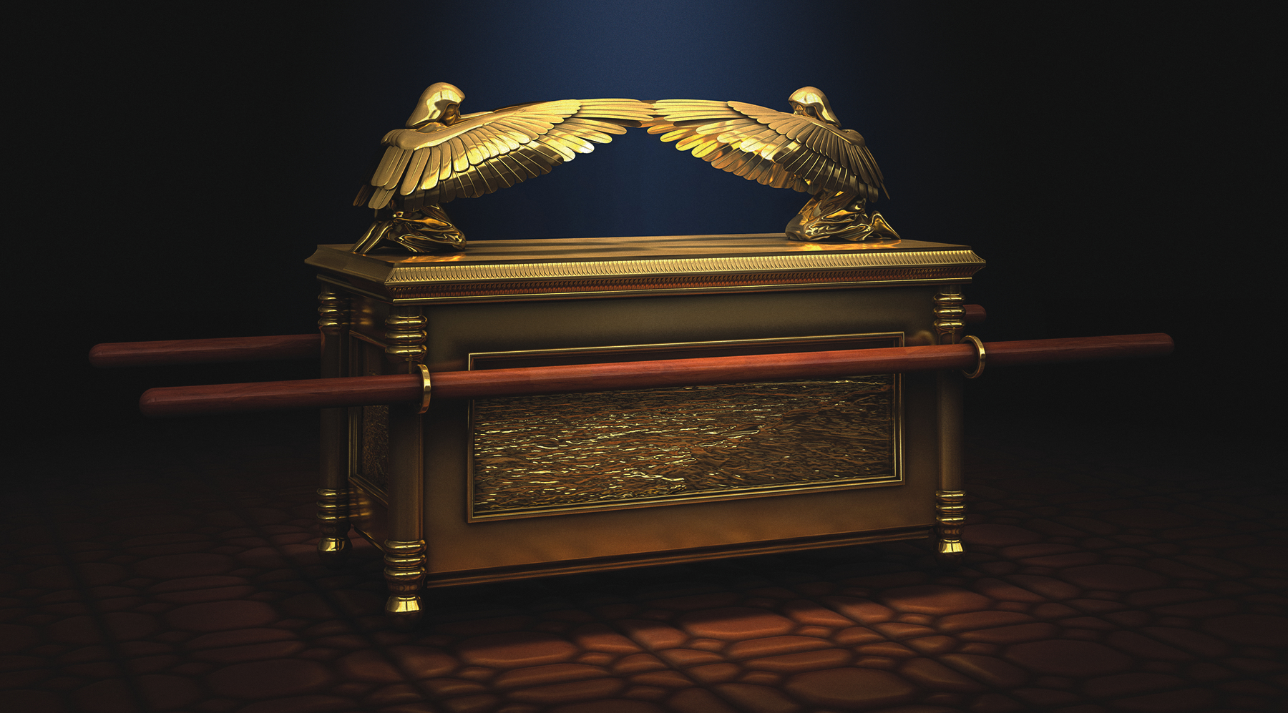
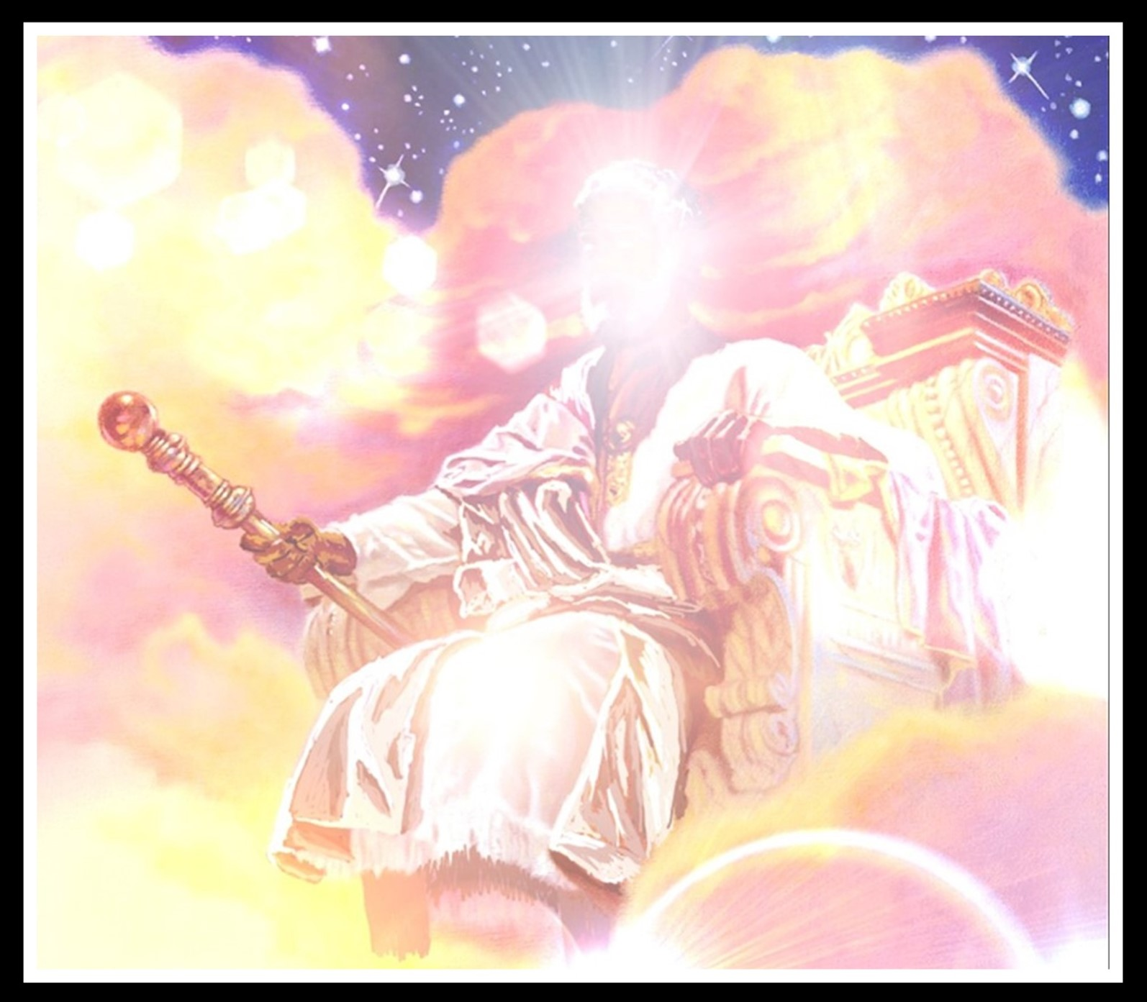
We must understand that there is only ONE mercy seat where the two golden cherubim is on the top of the ark of the covenant. This mercy seat of the ark is place inside the temple of the most holy sanctuary (Levi 16:2). Meaning ONE throne (seat) as is in the heavenly kingdom where is.

Slide 28
The other part we must not simply ignore about is, is the only SAVIOR & KING of the universe. There is NO ONE ELSE LIKE HIM who have the authority power doing the marvel work according to Isaiah 43:11; 44:6, 24, Psalm 148:13, Psalm 47:7, and 1st Kings 8:23.

Slide 29
This mean NO one like HIM who have or were given all the authority power to do the marvel work

Slide 30
There are more strange fact about the Revelation 21, it describe twelve precious stones walls with each names of the twelve apostles written on it. And it also describe the12 tribe of Israelites’ name written above the entering gate?
Nothing about this followship names are mentioned in the book of Ezekiel at all, or anywhere in the OT books. And what odder about the Revelation 21 walls is…
The measurements of the city lies foursquare, its length the same as its width. The city area measured with its reeds, 12,000 stadia. Its length and width and height are equal (V. 16). That measurements is well over 1K miles, HUGE different compare with what the Ezekiel describe 500 Reeds (that is not even a mile).

Slide 31
Again, the question earlier, whether there will be any future instruction to build the walls surround the city? And the answer is still NO!

Slide 32
What about this future prophecy new temple where our heavenly Father, the Creator ONE will dwell in again? Will there be a temple and the city’s wall in the coming last day?

Slide 33
The answer is still NO because…

Slide 34
There is still more problem in Revelation 21:
First verse mentioned that there NO SEA in this new kingdom also????
This conflict with what the Old Testament prophecy foretold about the new heaven and new earth according to Isaiah 35:6-7, Ezekiel 47:8-12, or Isaiah 60:5 all say about the sea. Like how this Dead Sea and even the Mediterranean Sea will become fresh waters (Ezekiel 47:10).

Slide 35
According to Zechariah 14:4; 8-9 - feet will stand on the Mount Olives…. this living waters will flow out from the temple and Jerusalem, half of them to the eastern sea, and the other half to the western sea. HE will be king over all the earth, on that day. will be the ONE and his name ALONE.

Slide 36
Praise to the I AM (HalauYAH), heaven and earth! Sea and everything in it, praise him! – this is the ideal possible why the sea living creator would not disappear - Psalm 69:34.
- PLS also read - Psalm 98:7

Slide 37
Last thing to understand from all this, is that Ezekiel's vision of the temple and Solomon’s temple are both similar diagram. Just as how the tabernacle was build are also similar diagram as Solomon’s temple. The tabernacle, Solomon's temple and Ezekiel’s vision of the future temple all have the similar diagram layout of the sanctuary. It’s because it’s ’s dwelling place where HIS mercy seat (throne) would be.

Slide 38
At last, you as reader may now starting to see why this Revelation 21 foursquare new kingdom does NOT logically make any sense or true at all. While Ezekiel’s book along with all other OT books logically all match.
There is NO SURROUNDING FOURSQUARE CITY WALLS because is our protection wall against the enemy (Isaiah 54:17). Reject the New Testament doctrine once for all.

