Slide 1
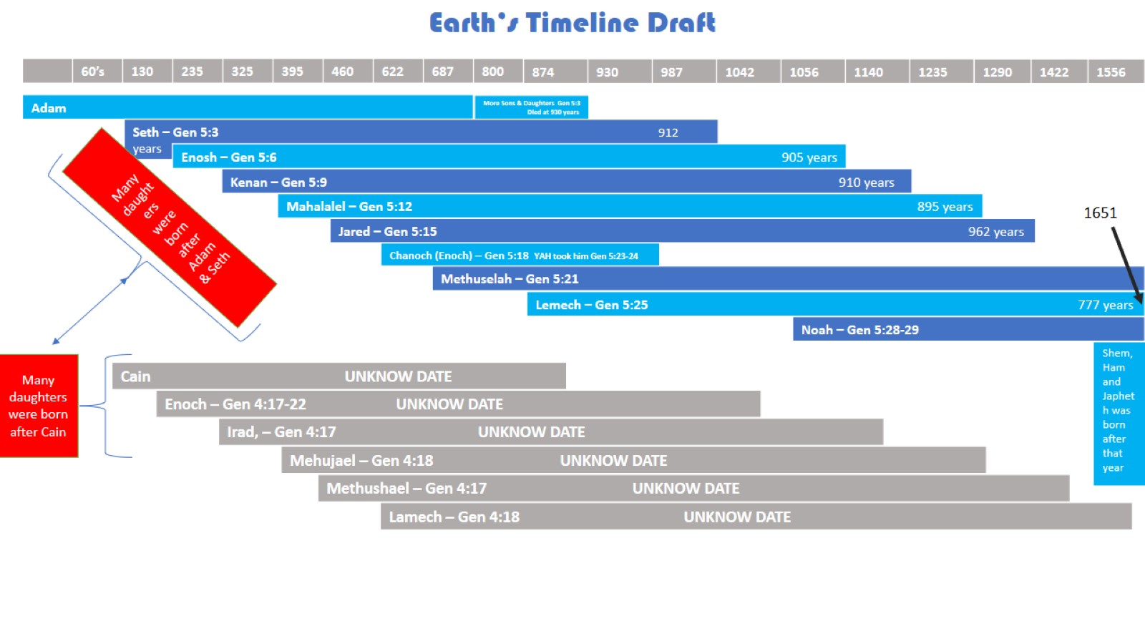
Earth’s Timeline Draft

Slide 2
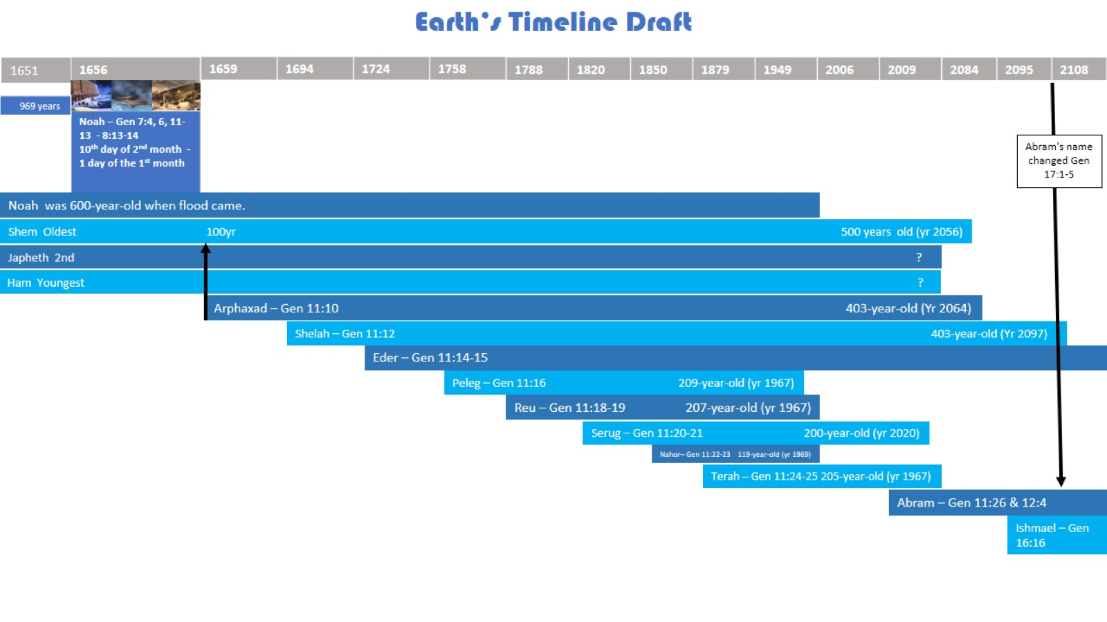
Earth’s Timeline Draft

Slide 3
Earth’s Timeline Draft

Slide 4
Earth’s Timeline Draft

Slide 5
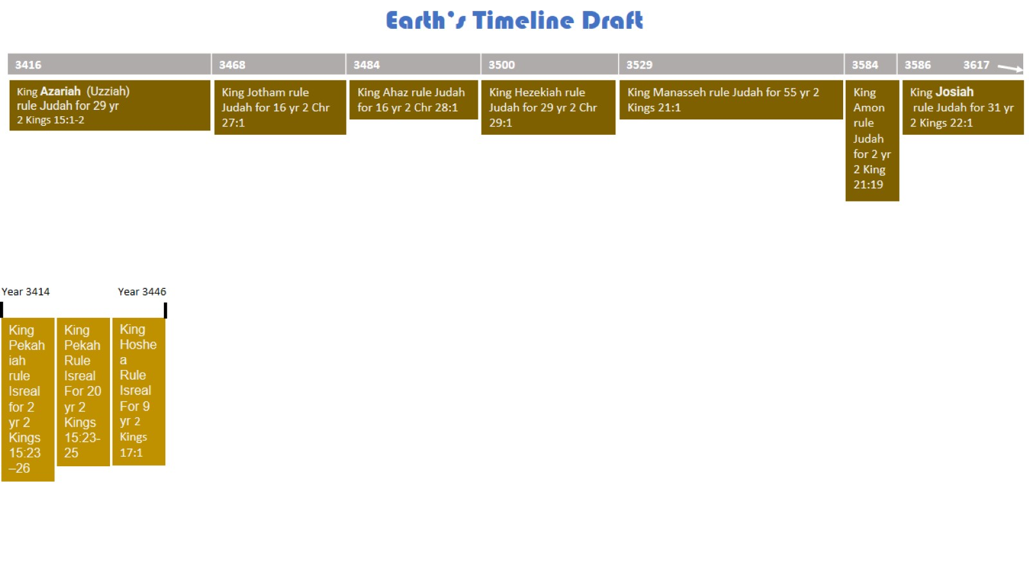
Earth’s Timeline Draft

Slide 6
Earth’s Timeline Draft

Slide 7
Earth’s Timeline Draft

