Slide 1
Earth’s Timeline Draft
 | 60’s | 130 | 235 | 325 | 395 | 460 | 622 | 687 | 800
874 | 930 | 987 | 1042 | 1056 | 1140 | 1235
1290 | 1422 | 1556
Adam
More Sons & Daughters Gen 5:3 Died at 930 years
Many daughters were born after Adam & Seth
Seth – Gen 5:3 912 years
Enosh – Gen 5:6 905 years
Kenan – Gen 5:9 910 years
Mahalalel – Gen 5:12 895 years
1651
Jared – Gen 5:15 962 years
Chanoch (Enoch) – Gen 5:18 YAH took him Gen 5:23-24
Methuselah – Gen 5:21
Lemech – Gen 5:25 777 years
Noah – Gen 5:28-29
Many daughters were born after Cain
Shem, Ham and Japheth was born after that year
Cain UNKNOW DATE
Enoch – Gen 4:17-22 UNKNOW DATE
Irad, – Gen 4:17 UNKNOW DATE
Mehujael – Gen 4:18 UNKNOW DATE
Methushael – Gen 4:17 UNKNOW DATE
Lamech – Gen 4:18 UNKNOW DATE

Slide 2
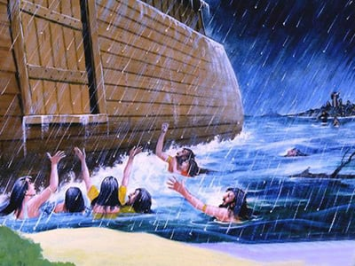
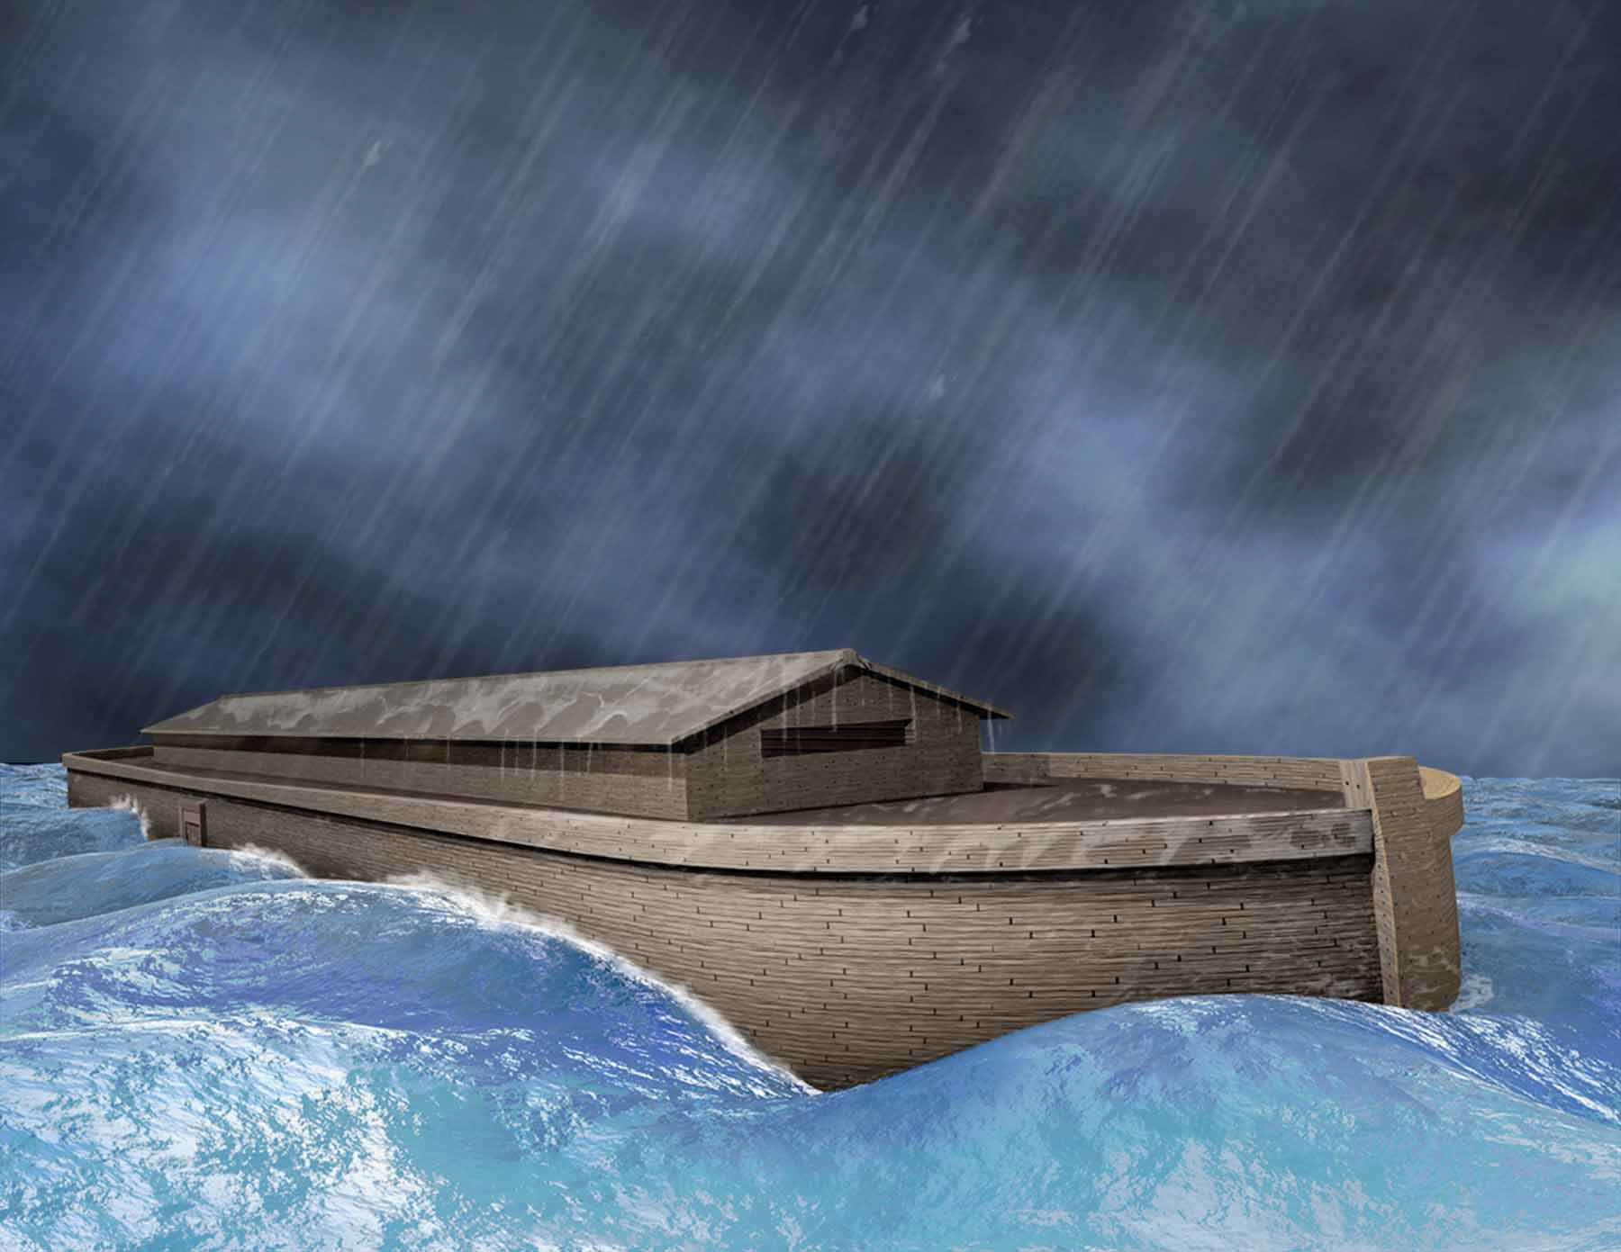
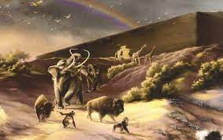
Earth’s Timeline Draft
1651
1656 1657
1659 | 1694 | 1724 | 1758
1788 | 1820 | 1850 | 1879 | 1949 | 2006 | 2009
2084 | 2095 | 2108
Methuselah 969 yr
Noah – Gen 7:4, 6, 11-13 - 8:13-14 10th day of 2nd month - 1 day of the 1st month Noah was 600-yr old when flood came. 601 when ground dry.
Abram's name changed Gen 17:1-5
Noah
Shem Oldest Shem was 100 years old at the birth of Arphaxad, two years after the flood. 500 years old (yr 2056)
Japheth 2nd ?
Ham Youngest ?
Arphaxad – Gen 11:10 403-year-old (Yr 2064)
Shelah – Gen 11:12 403-year-old (Yr 2097)
Eder – Gen 11:14-15
Peleg – Gen 11:16 209-year-old (yr 1967)
Reu – Gen 11:18-19 207-year-old (yr 1967)
Serug – Gen 11:20-21 200-year-old (yr 2020)
Nahor– Gen 11:22-23 119-year-old (yr 1969)
Terah – Gen 11:24-25 205-year-old (yr 1967)
Abram – Gen 11:26 & 12:4
Ishmael – Gen 16:16

Slide 3
Earth’s Timeline Draft
2108 | 2109 | 2149 | 2169 | 2184 | 2209 | 2232 | 2260 | 2289 | 2277
2299 | 2316 | 2346 | 2397 | 2649 | 2729 | 2769
3209 | 3216
Eder 430-year-old (Yr 2154)
Joseph was 17 yr old salve in Egypt Gen 37:2, 28
Jacob arrived in Egypt Gen 47:9
Temple Completed during Solomon’s 11 yr reign
1 King 6:37-38
Abraham – Gen 17:1-5 175 years old
Ishmael Died at 137 yr old
Isaac – Gen 17:19-21 & 18:10-14 & 21:5
Rebekah
Jacob - Gen 25:25-26 Died at 147 yr
Joseph – Gen 41:46-57 & 45:6, 28 Died at 137-year-old
Manasseh and Ephraim was born before the yr of 2297, before famine year.
Levi - live 137 yr Ex 6:16
Moses – Ex 7:7 Deut 34:7
40 yr wandering in wilderness
430 yr of salve in Egypt
Esau married 2 wives Gen 26:34
1 Kings 6:1 & 2 Chor 9:29: 480 years after left Egypt, Temple begin to build during Solomon’s 4th years reign over Israel
Esau - Gen 25:25-26 Age of death unknow
Sodom & Gomorrah was destroyed

Slide 4
Earth’s Timeline Draft
3247 |  |  | 3264 | 3267 |  | 3306 |  | 3331
3339 | 3341 | 3347 | 3387 | 3416
Rehoboam, was 41 years old when he became king of Judah
1 Kings 14:21-31
Abijah – rule Judah for 3-year 1 King 15:1
Asa rule Judah 39 yr 2 Chro 16:11-14
Jehoshaphat ruled Judah for 25 years 1 King 22:41-42
king Jehoram rule Judah – 2 Kings 8:16-24
King Ahaziah only rule 2 yr
2 King 8:25-26
Queen Athalia ruled after King Ahaziah 2 Kings 11:3
King Joash
At 7-year-old rule Judah for 40 yr
2 Kings 11:21-12:1
King Amaziah
rule Judah
2 Kings 14:1-2, 17
Year 3369
Year 3386
Year 3402
EliYAH was living on earth during this time etc… 1 Kings 19:9-18
It may-be about 2,313 plus year since YAH had taken EliYAH alive in heaven.
Elisha was ill to death on the day Jehoash was King of Israel (2 Kings 13:14)
Jehu (son of Jehoshaphat the son of Nimshi) was a commander in the army of Ahab (2 Kings 9:5, 25), until he became the king of Israel for 28 year (1 Kings 19:16 & 2 Kings 10:35–36)
Jehoahaz the son of Jehu began to reign over Israel 17 yr (2 Kings 13)
Joash (Jehoash) king of Israel for 16 yr
King Jeroboam II rule Isreal for 41 yr 2 Kings 14: 23 – 29

Slide 5
Earth’s Timeline Draft
3416 | 3468 | 3484 | 3500 | 3529 | 3584 | 3586 3617
King Azariah (Uzziah)
rule Judah for 29 yr
2 Kings 15:1-2
King Jotham rule Judah for 16 yr 2 Chr 27:1
King Ahaz rule Judah for 16 yr 2 Chr 28:1
King Hezekiah rule Judah for 29 yr 2 Chr 29:1
King Manasseh rule Judah for 55 yr 2 Kings 21:1
King Amon rule Judah for 2 yr 2 King 21:19
King Josiah
rule Judah for 31 yr 2 Kings 22:1
Year 3443
Year 3453 3455
Year 3476
Year 3476
King Jeroboam II rule Isreal for 41 yr 2 Kings 14: 23 – 29
King Zachariah rule Isreal for 6 month
2 Kings 15:8
King Menahem rule Isreal for 10 yr
2 Kings 15:17
King Pekahiah rule Isreal for 2 yr 2 Kings 15:23–26
King Pekah
Rule Isreal
For 20 yr 2 Kings 15:23-25
Hoshea was the nineteenth and last king of Israel and son of Elah (not the Israelite king Elah).
Rule for 9 yr 2 Kings 17:1

Slide 6
Earth’s Timeline Draft
3617 |  | 3628 | 3628 | 3639 |  |  |  | 3709
3928 |  | 4107
King Jehoahaz
rule Judah for 3 month 2 Chr 36:2
King Elakim (Jehoiakim)
rule Judah for 11 yr 2 Kings 23:36 & 2 Chr 36:4
King Jehoiachin(Coniah & Jeconiah) rule Judah for 3 month 2 Chro 36:9 & 2 kings 24:8
King Zedekiah (Mattaniah) rule Judah for 11 yr 2 Chr 36:11
Greece Empire
About 179 year later Rome conquered Greece in 146 BC
Medo-Persian Empire rule for about 219 year
Darius III was defeated by Alexander the Great. The end of Persian Empire
Kings of the Persian Empire - Bible History (bible-history.com)
The end of Judah ruling – 2 Kings 25:1-7
1st year of King Cyrus of Persia release YAH's people and went back to Jerusalem - 2 Chronicles 36:22-23 & Ezra 5:13 & 6:3
Temple stopped rebuilding until 2nd year of the reign of Darius king of Persia according to Ezra 4 & Haggai 1
Even Talmud mentioned in Erchin 12b (Yoma 4b), claimed that the 2nd Temple stood for 420 years.
Exile in Babylon for 70-year end – 2 Chr 36:21 Also called 70 yr land of Shabbath rest
2nd Temple start rebuilding.
Joshua (Jeshua) son of Jehozadak, Zechariah, and Haggai here during the year of King Darius 2nd year and 6 month
1st Temple was destroyed
for 3 month
for 3 month
7 week
62-week Dan 9:25 (7*70 = 490 YEARS)

Slide 7
Earth’s Timeline Draft
Paganism BC & AD timeline
4199 | 4318 0 | 4545 | 4708 | 4821 |  |  |  |  | TODAY - 6313
About 119 year later Roman Republic became the Roman Empire in 27 BC
About 227 year later Roman Kingdom began to decline starting around 200 AD
By 400 AD Roman Kingdom was struggling under the weight of how many nations (Europe) grew were too large for Rome to handle. The city of Rome finally fell in 476 AD
It had been about 1492 years ago when Roman last rule the world power
Pagan Zero A.D. Time
(4345)
Julian the Apostate attempt to rebuild the Jewish Temple in 363
The Pagan Year
2022
2nd Temple was already destroyed before Jesus’ time???
Jesus ascend into heaven between the year 30–36 A.D.
(4375- 4381)
?
?
490 YEARS
Prophecy end here and the 2nd Temple destroyed
(7*70=490 YEARS)
175 years, between the time of 2nd Temple was destroyed and the time Jesus.
That is well over 2353 or 2359 years ago, opposite to what we were told is 1992 or 1986 years ago?

